Slide 1



Intrinsic Video and Applications
Genzhi Ye Elena Garces Yebin Liu Qionghai Dai Diego Gutierrez
Tsinghua University Universidad de Zaragoza
Notes:
Thanks for the introduction.
Now I’m going to present our work on Intrinsic video and applications.

Slide 2
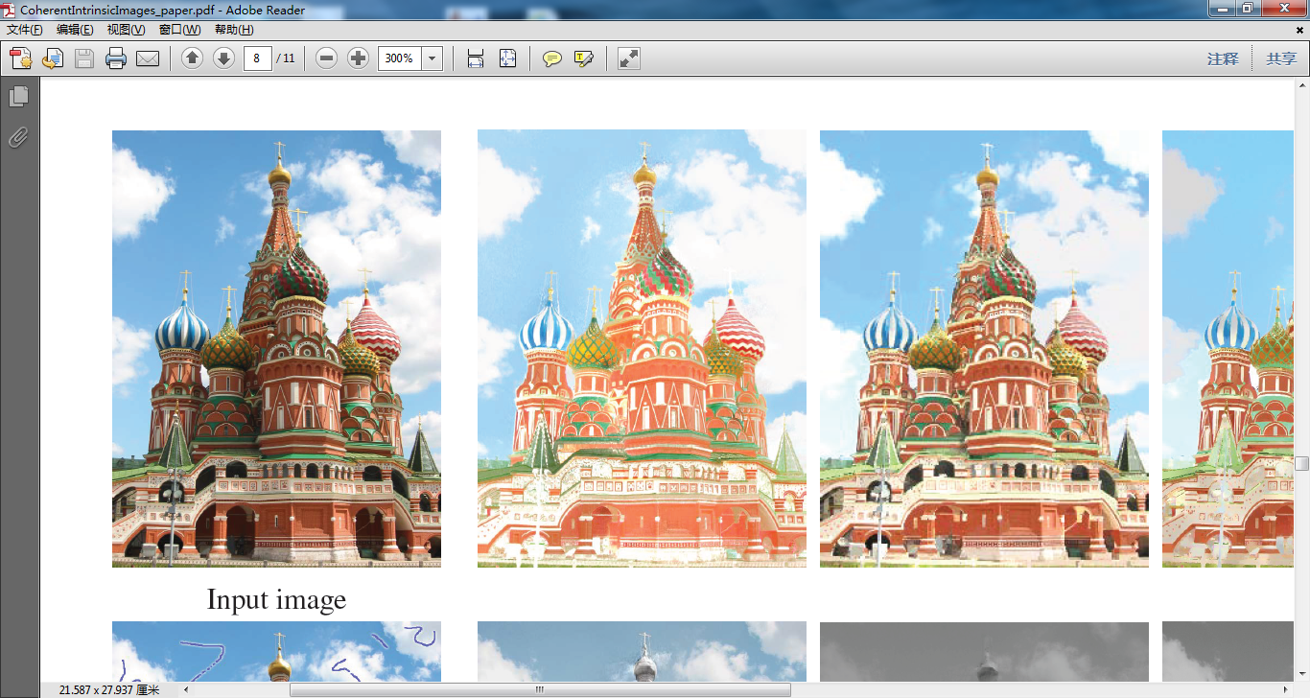
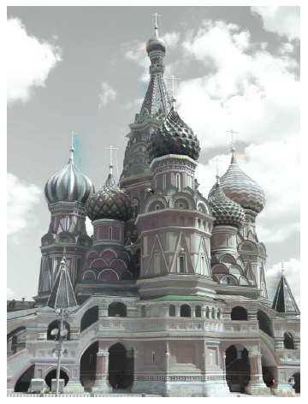
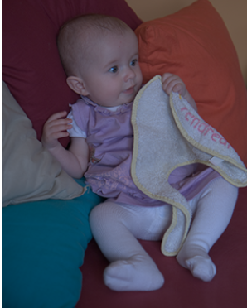
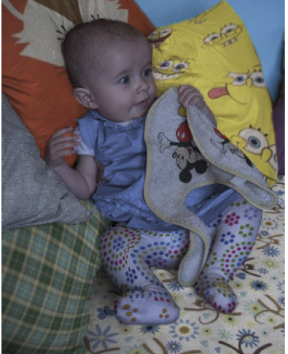
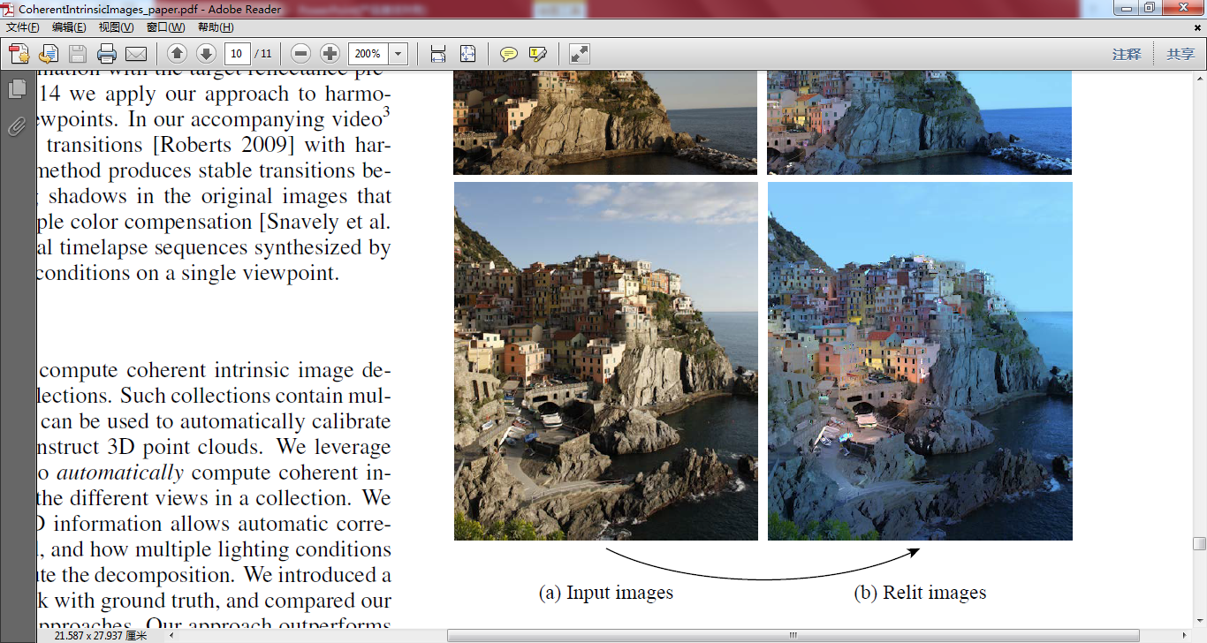
Intrinsic images
Formulation
Applications: Retexture and Relight
[Garces 2012]
Input image
Reflectance
Shading
Surface BRDF
Surface normal
Global illumination
Occlusions
[Laffont 2012]
Notes:
Let me use an example of intrinsic images to introduce the definition of intrinsic . This have been a hot topic in Graphics for decade, which aim to decompose an input image into per-pixel multiplication of reflectance and shading layer.
This is a extremely ill-posed problem since you want to solve 2 unknowns out of only one equation.
Here, Reflectance layer encodes surface BRDF attributes. Shading contains information of surface normal, global illumination and occlusions.
Such decomposition enables fancy applications for image editing task. Two of the most common ones listed here are retexture and relight.

Slide 3
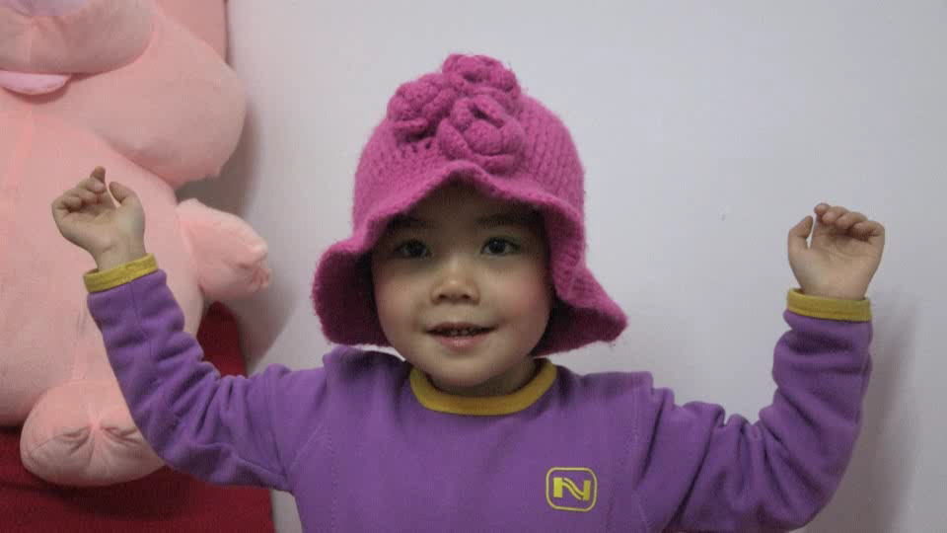
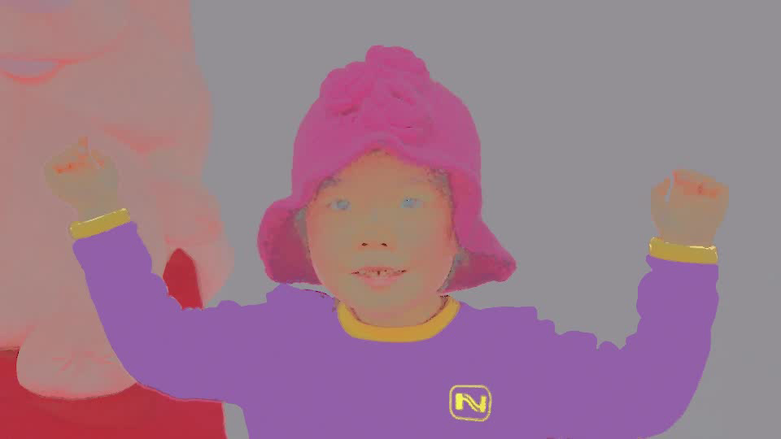
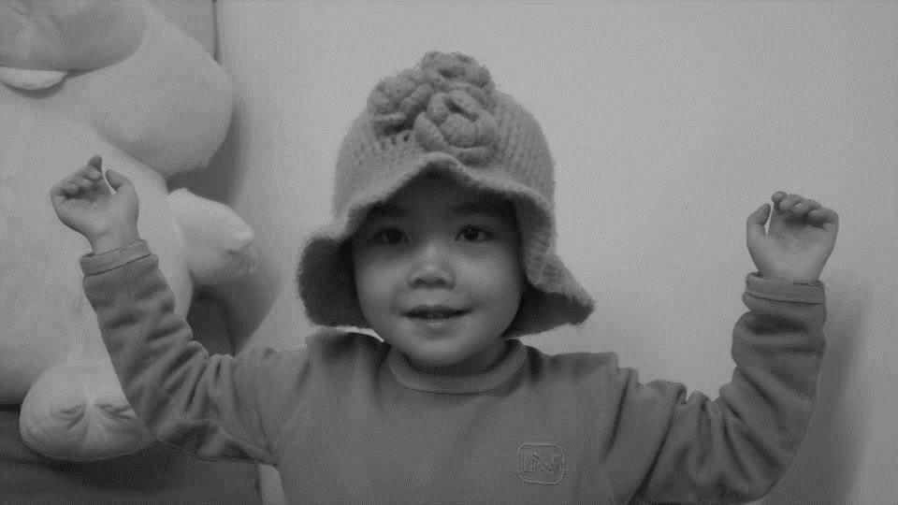
Intrinsic Video …
Input video
Reflectance layer
Shading layer
Notes:
In this work, We extend the notion of intrinsic images to intrinsic video, which intend to find reflectance and shading layer for each individual video frames, while keeping temporal coherence at the same time.

Slide 4
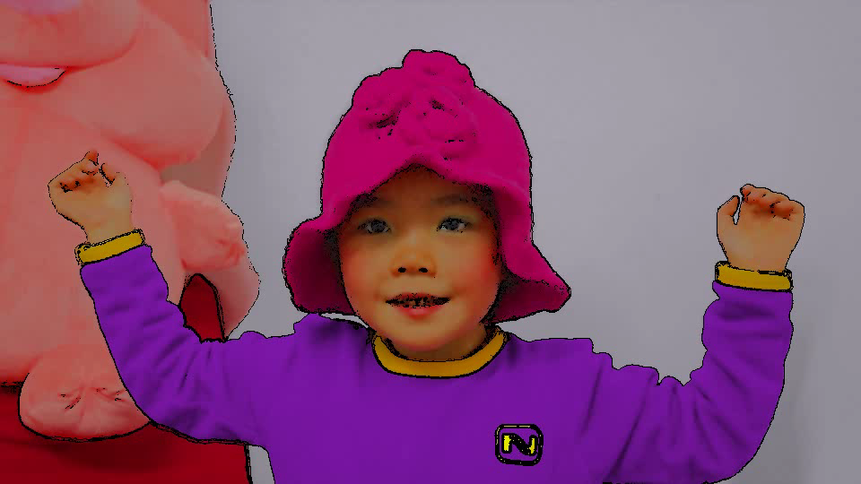
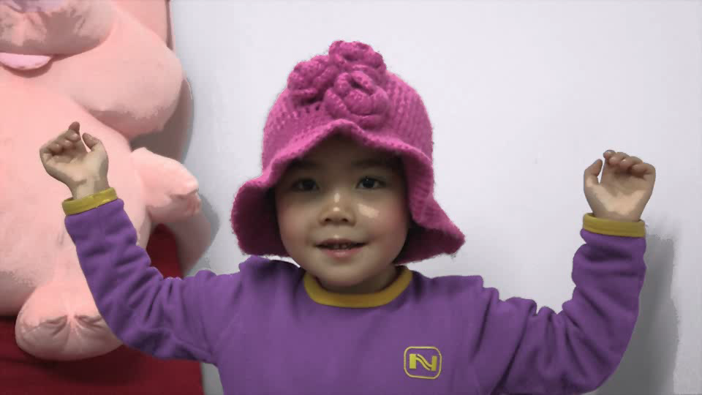
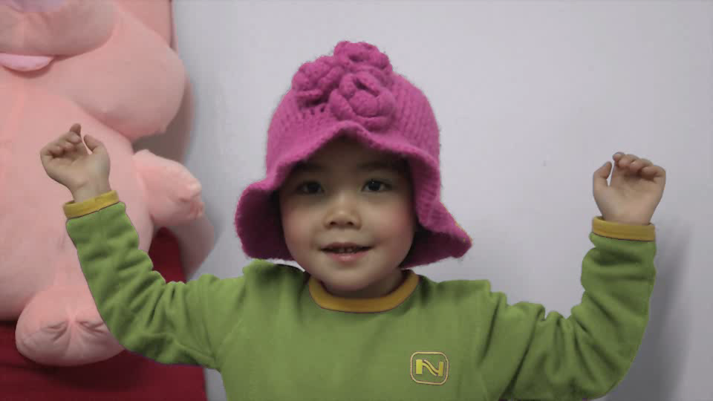
… and Applications
Input
Stylization
Material editing
Recoloring
Notes:
Based on such intrinsic decomposition, we present several video editing applications, by manipulating reflectance or shading layer independently, you can achieve stylization, recolor, material editing. Here we apply curve editing on shading layer and make the girl’s face more smooth and waxy.

Slide 5
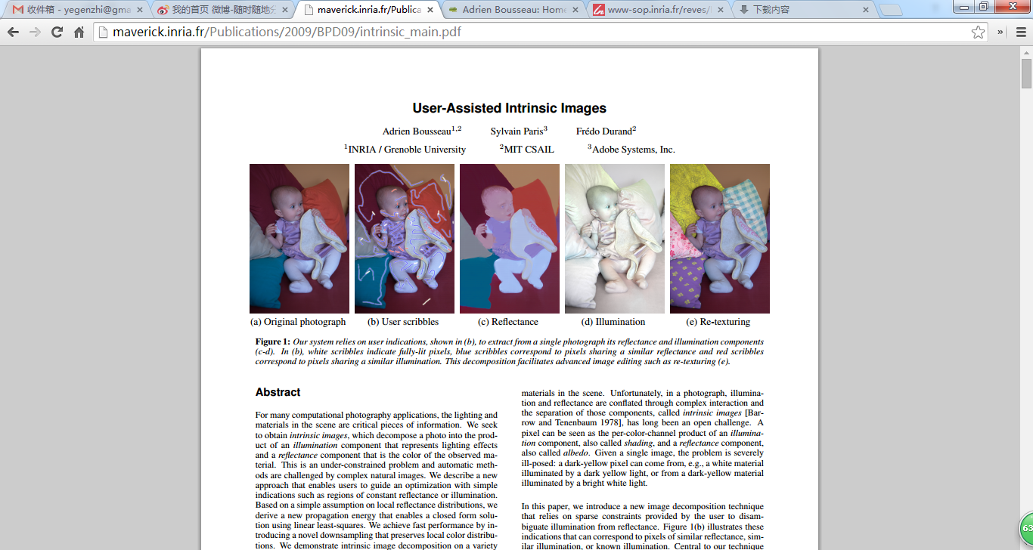
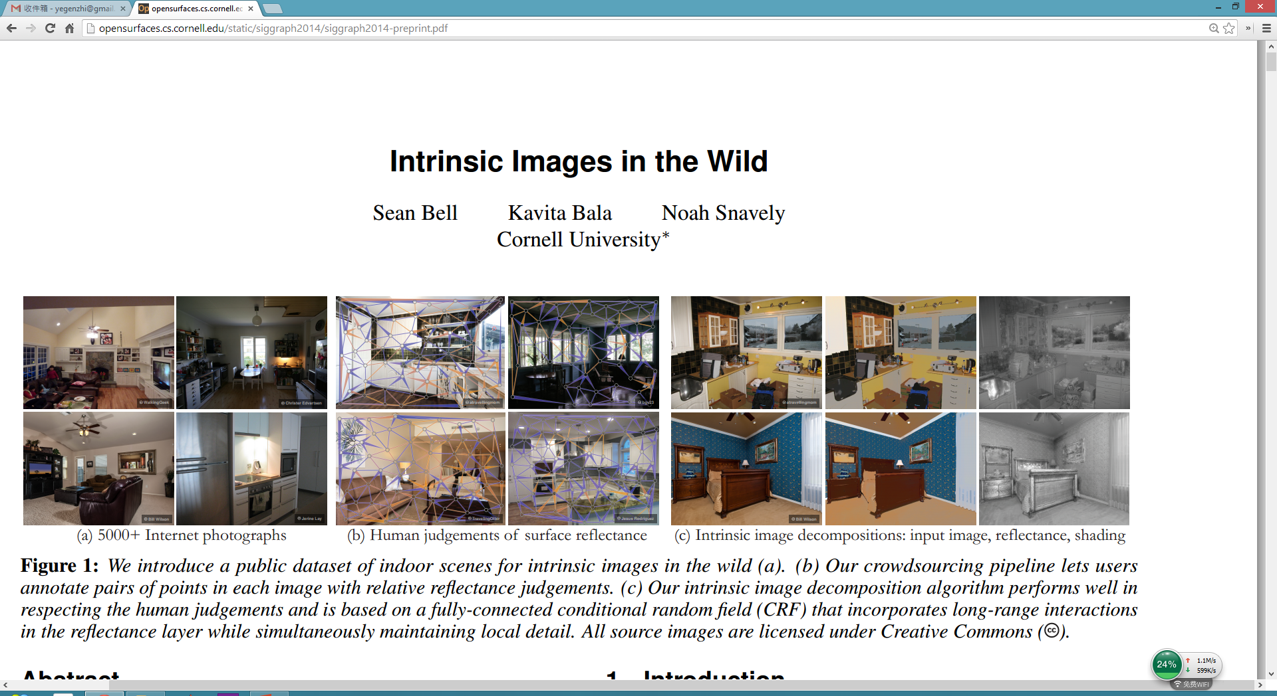
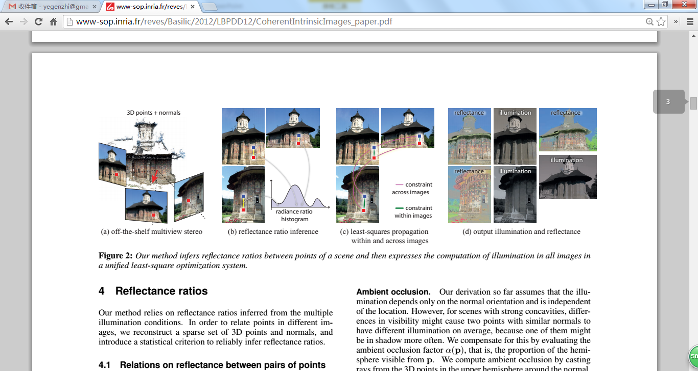
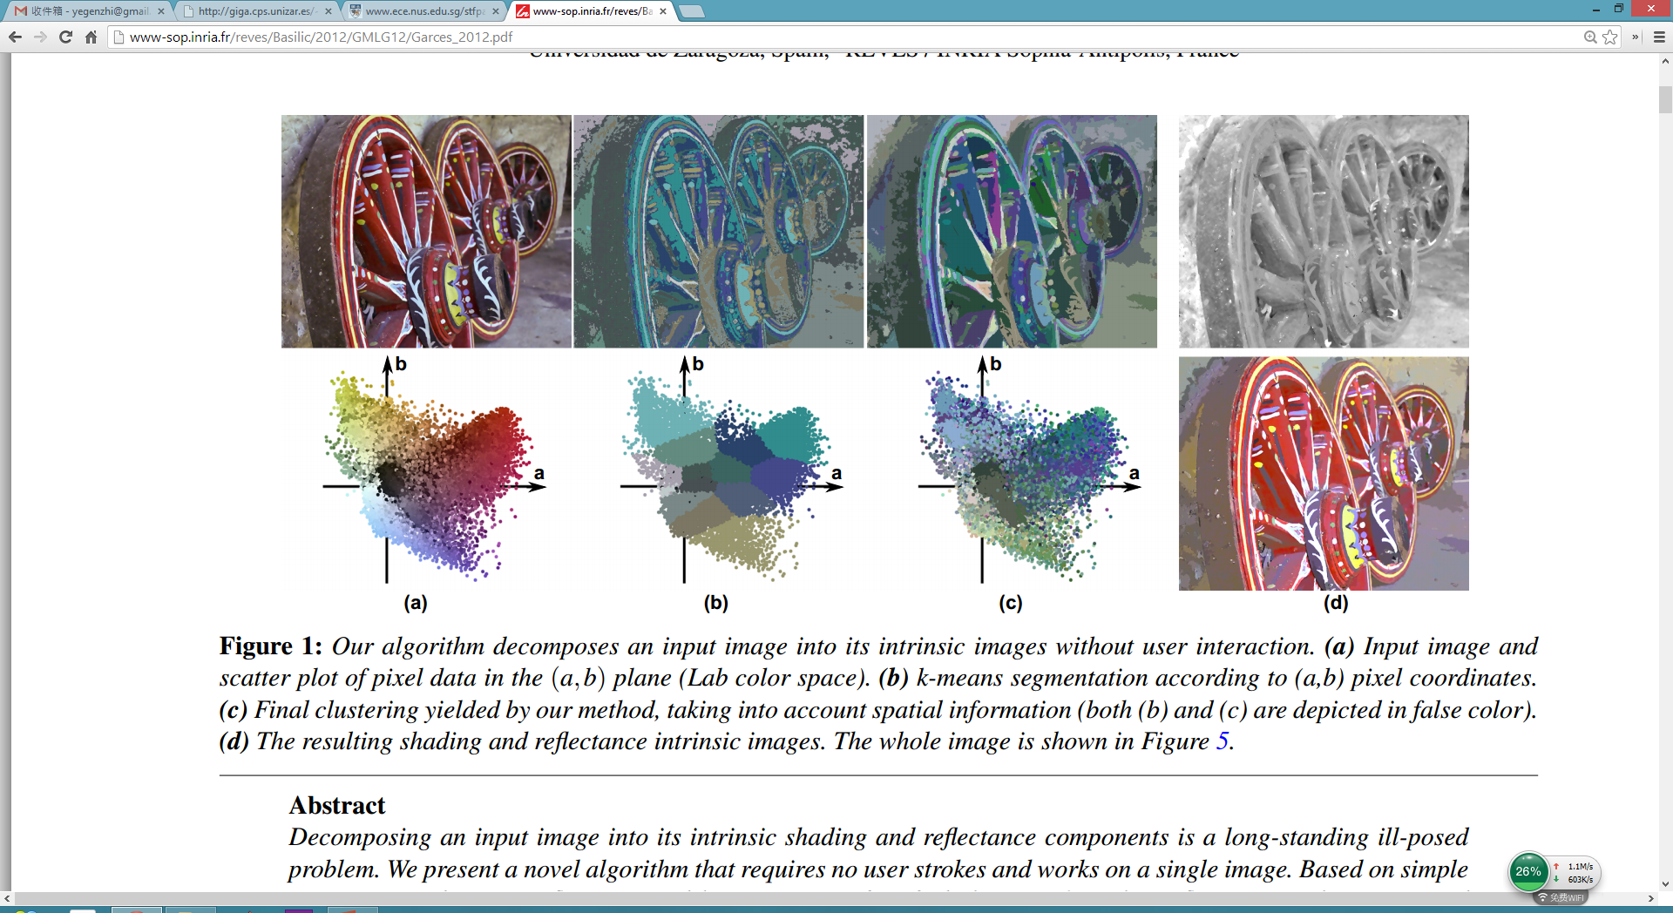
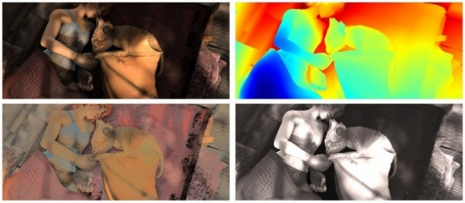
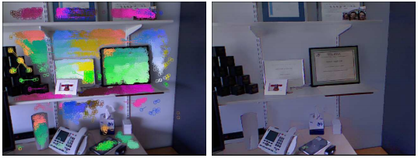
The space of intrinsic images
 | Single image | Multiple views | Video sequence
RGB image
With depth cues
[Bousseau 2009] [Bell 2014]
[Zhao 2012] [Garces 2012]
[Chen 2013]
[Laffont 2012]
[Lee 2012]
Notes:
Here we briefly categorize previous works .
In most recent years, there are numerous works aim to decompose reflectance and shading components from single image (with or without user interaction), there are also works tackling single rgbd image, multi-view images, or rgbd video from Kinect camera.
But by far, we notice that there is still a blank area in the domain of extracting intrinsic from a natural RGB video sequence. Our work put this problem on table and present a first solution for that.

Slide 6
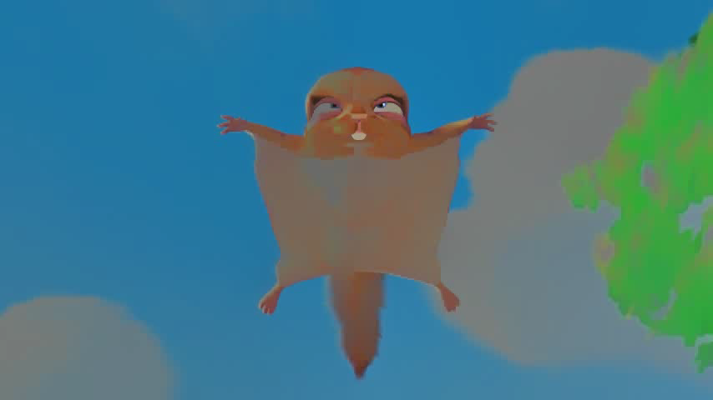
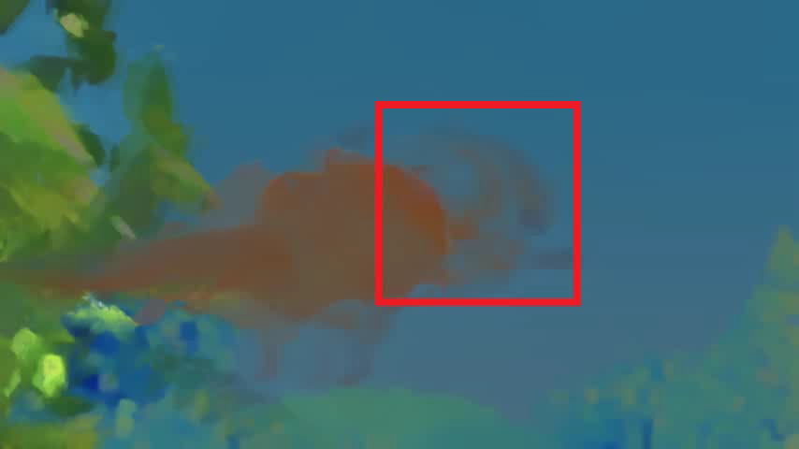

Possible solution #1
Decompose per frame
Post-smoothing
Temporal jittering
Ghosting effect
Intrinsic image [Zhao 2012]
Temporal consistency [Lang 2012]
Notes:
Very quickly, one may came up with a solution that applying intrinsic images method on each individual frame, we apply the state-of-art automatic single image method, and get a result as shown here.as you can see. The result exhibit strong jittering artifact.
Next intuitive step should be imposing temporal coherence in a post-smoothing step. Again, we use a piece of state of art work to try, the temporal jittering is greatly reduced, but at the cost of introduction of the ghosting effect.

Slide 7



Possible solution #2
Decompose first frame
Propagate others
Manual intervention
Accumulation error
Intrinsic image [Zhao 2012]
Video snapcut [Bai 2009]
Notes:
Another thought could be— decompose the first frame and propagate for others. We try the propagation strategy from videosanpcut, which is the most practical propagation method and already been integrated into Adobe after effect. The results could be OK, but given the premise that you need to manually pause the propagation, fix some propagation error, and then go on. If you want to do this fully automatically, the accumulation error will be a big problem.

Slide 8
Motivation
Intrinsic video
  Temporal coherence
  No ghosting effects
  Minimal user inputs
  No error accumulation
Unified framework combining decomposition and propagation
Coherent constraints
Auto-Reinitialization
 | Decomposition
 | Propagation
Notes:
By far, we have introduced two possible ways to do this and gain a deeper understanding of intrinsic video problem.
Now, We can summarize our goal of intrinsic video, which is:
Maximize the temporal coherence while minimize the user input. Neither ghosting effect nor accumulation error should be observed.
For doing that, we present a unified framework to combine deposition and propagation. where decomposition and propagation act in a mutually beneficial way for each other.
With constraint from propagated information, decomposition for single frame will act in a more temporal coherent way.
In propagation, decomposition play a role of automatic correction and completion.
We will explain the framework in detail.

Slide 9

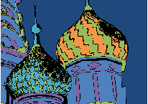

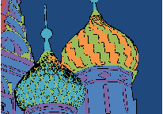

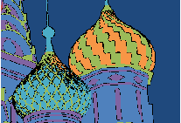
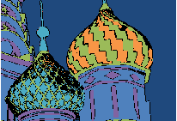
Algorithm overview
Reflectance Clustering
Reflectance Propagation
Reflectance completion
Video frames
Clustering for
the first frame
Forward propagation
Backward propagation
Notes:
The pipeline is: we first decompose the initial frame to reflectance and shading, and then segment the reflectance image into clusters. We will use the cluster definition to proceed further propagation.
For alleviating the accumulation error as few as possible. We only propagate value we are sure about. For others we leave it blank for future operation
With the propagation goes far, there will be more and more blank pixels are left. As you can see in the upper left window, the black pixels will grow. when the blank area is sufficient large, we stop the propagation and complete as much blank pixels as we can using a constrained completion in the stopping frame.
We integrate the completed information into clusters ,carry such information and propagate it back.
then propagation goes forward and backward with same strategy until all the video frames have been processed.
We will break down each individual part now.

Slide 10
Decomposition & Clustering
Reflectance Clustering
Reflectance Propagation
Reflectance completion
Video frames
Clustering for
the first frame
Forward propagation
Backward propagation

Slide 11

Decomposition & Clustering
First frame
Reflectance layer
[Zhao 2012]
Graph-based segmentation
[Felzenszwalb 2004]
Notes:
We first decompose the first frame into reflectance and shading using a modified version of [Zhao 2012]. And then we perform graph-based segmentation on the reflectance image. That is to collect similar reflectance into one single cluster.
Based on such segmentation index, we put all the image pixel information into histogram for each cluster.
Compared to a naïve pixel-based propagation, propagating clusters will gain more efficiency and robustness.

Slide 12
Propagation
Reflectance Clustering
Reflectance Propagation
Reflectance completion
Video frames
Clustering for
the first frame
Forward propagation
Backward propagation

Slide 13



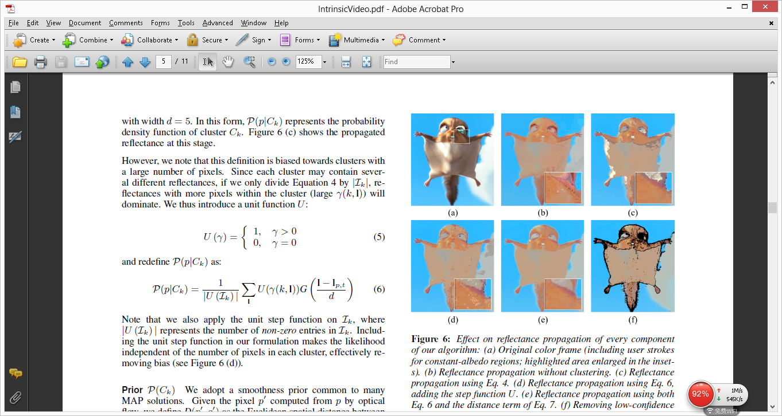
Propagation
Likelihood
Prior
t-1
t
Input
Likelihood only
Likelihood & prior
Notes:
We explicitly leverage temporal information by using optical flow to track the query pixel back to previous frame. And then we propose a probabilistic approach, formulating a Bayesian Maximum a Posteriori problem to drive the propagation of clustered reflectance values from the previous frame.
Here we intend to find the most appropriate cluster out of the 5 color labels that the query pixel belongs to. Note that the criterion consists of a likelihood term and smooth prior. Likelihood define how much possible does a pixel belongs to a cluster. The segmentation result only with this term are generally OK but noisy. We further introduce a smooth prior that consider the spatial location between pixels and clusters. Results are improved with this two term combined.

Slide 14
Completion
Reflectance Clustering
Reflectance Propagation
Reflectance completion
Video frames
Clustering for
the first frame
Forward propagation
Backward propagation

Slide 15
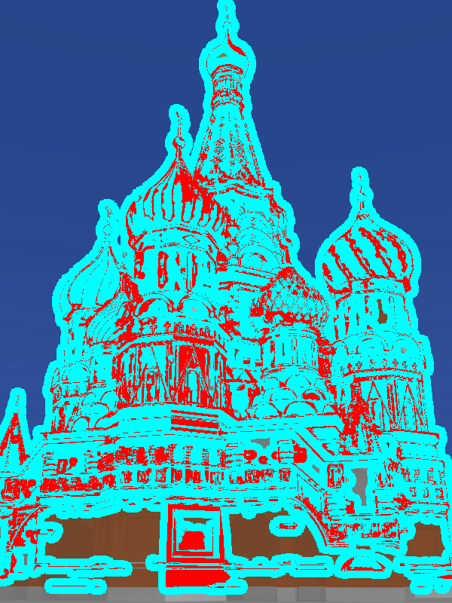

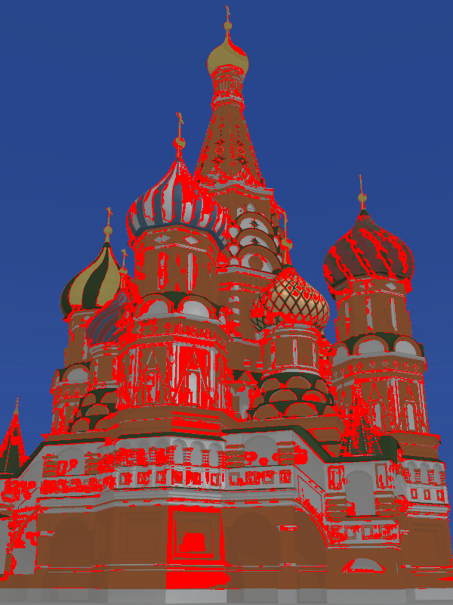

Completion
Stop when blank area grows to certain size
Solve pixels in red
Gather coherent constraints from cyan
Blend with Poisson image editing
Automatic scheme to reinitialize propagation
while keeping coherence
Handle occluded and un-occluded area
Notes:
When the amount of blank pixel reach a threshold, we stop the propagation, complete them, using those propagated value as constraints to keep it coherent with previous frames.
We use retinex model to solve unknown pixels in red, gather coherent constraint in cyan. And blend such propagated reflectance and completed reflectance using poisson image editing.
The advantage to doing this are two:
Such completion is an automatic scheme to recover and reinitialize the propagation. You can see this as a replacement of the user intervention in video snapcut
Two. By combine forward and backward propagation. We can handle occlusion very well. This is because when you going backward, forward occluded objects will become visible at the beginning.

Slide 16
Recap
Reflectance Clustering
Reflectance Propagation
Reflectance completion
Video frames
Clustering for
the first frame
Forward propagation
Backward propagation
Notes:
After introduce all the building blocks of the entire framework, let’s review it briefly.
Decompose the first frame and cluster
Propagate reflectance forward only for confident pixels. When those unconfident pixels reach certain amount, we complete this frame and propagate completed reflectance backward. And re-initialize the propagation from stopping frame.

Slide 17
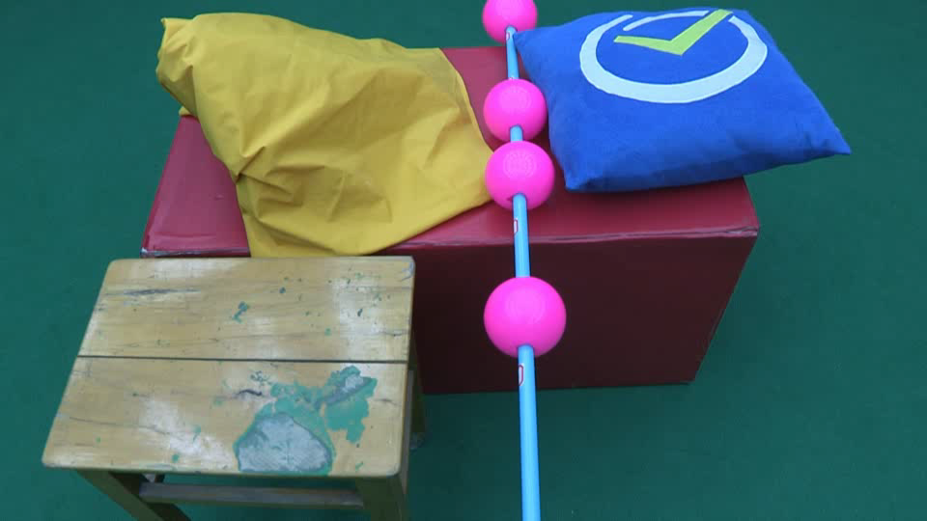
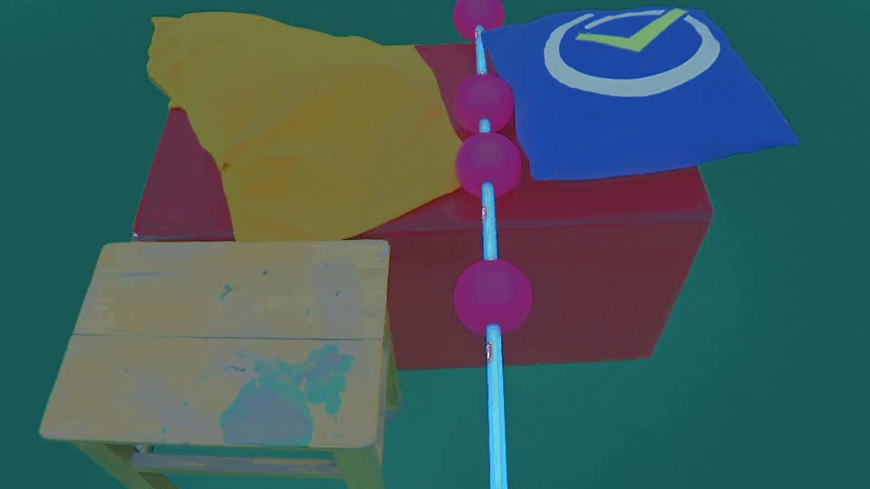
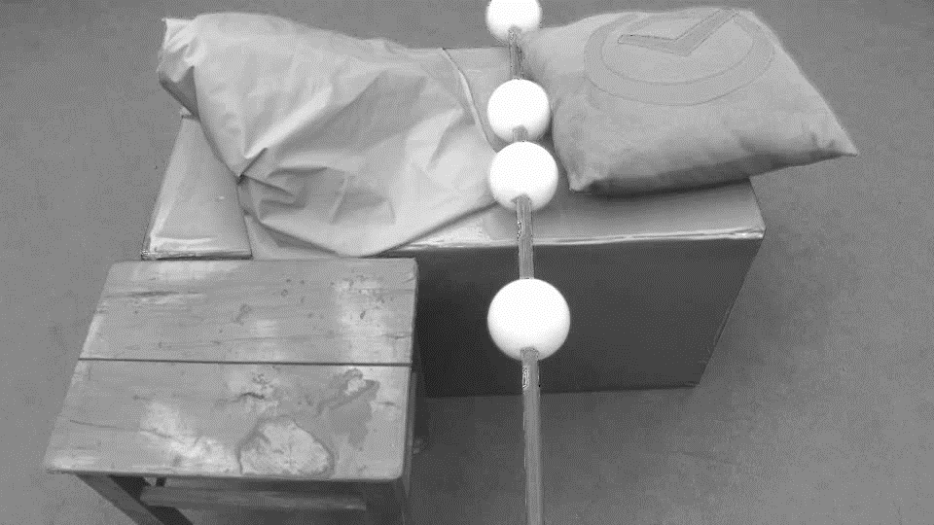
Intrinsic video results
Input
Reflectance
Shading
Notes:
Here we show some good decomposed reflectance and shading result produced by our proposed method.

Slide 18
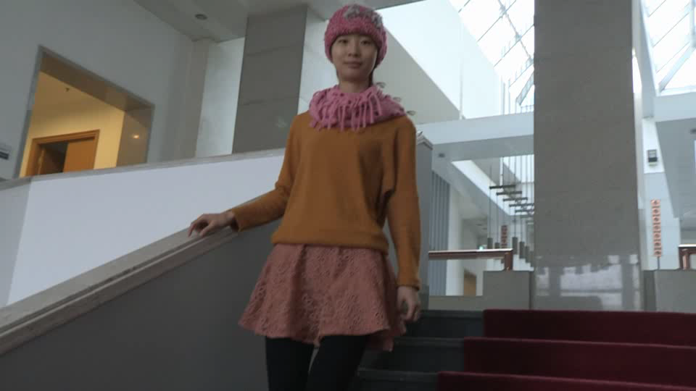
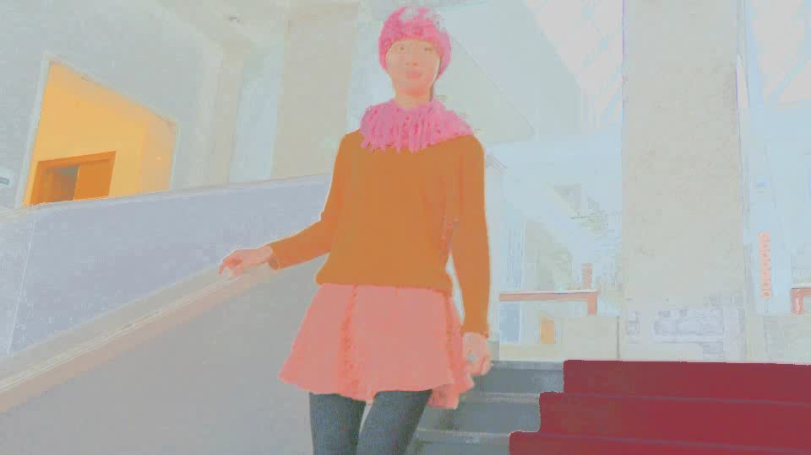
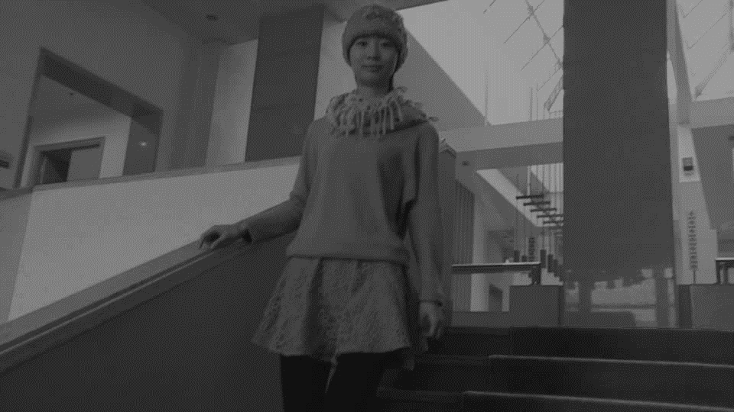
Intrinsic video results
Input
Reflectance
Shading
Notes:
This is another example. For more, please refer to the paper and companion video.

Slide 19

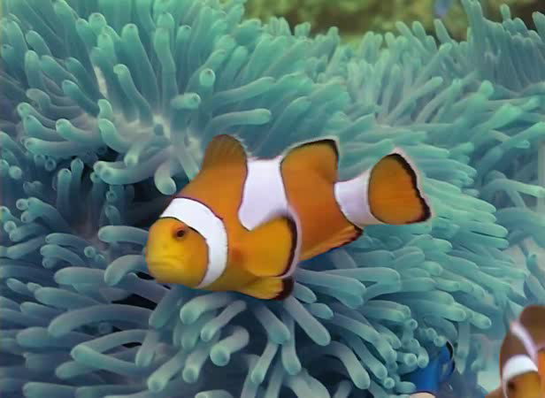
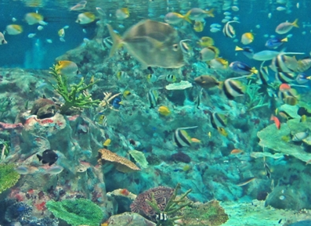
Applications
Input video
Reference image
Result
Notes:
We are going to show some applications enabled by intrinsic decomposition. Here is a video recoloring application by manipulating the reflectance layer and put the shading layer back. Which equal to changing texture under original light condition.

Slide 20
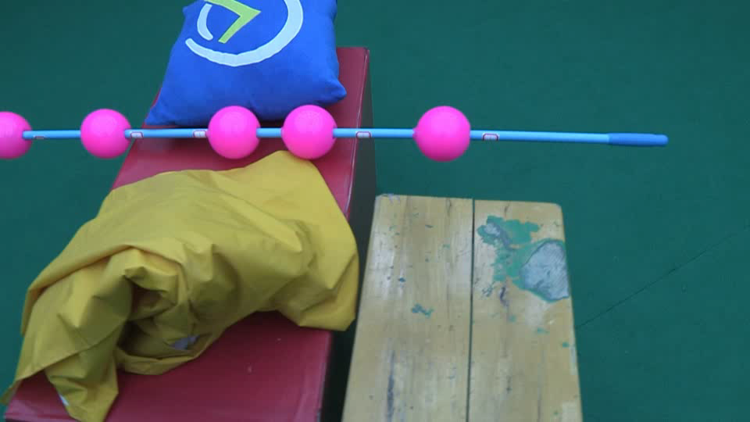
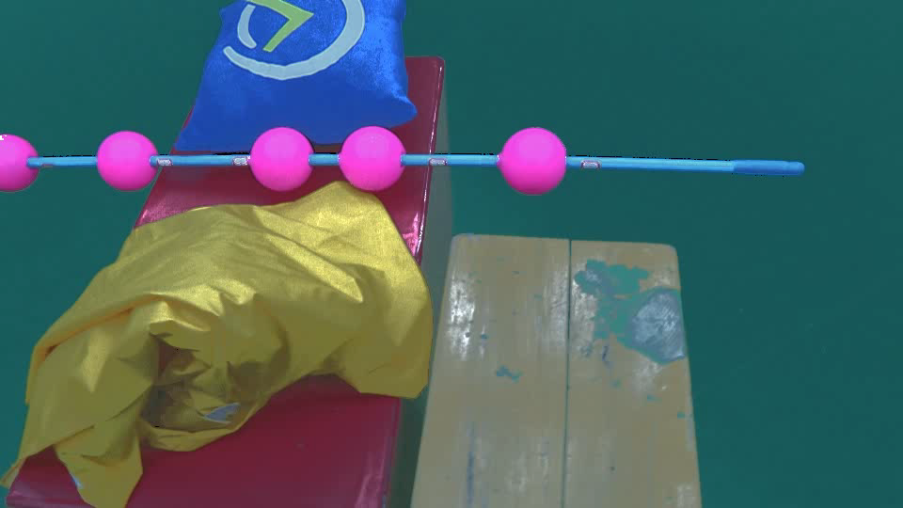
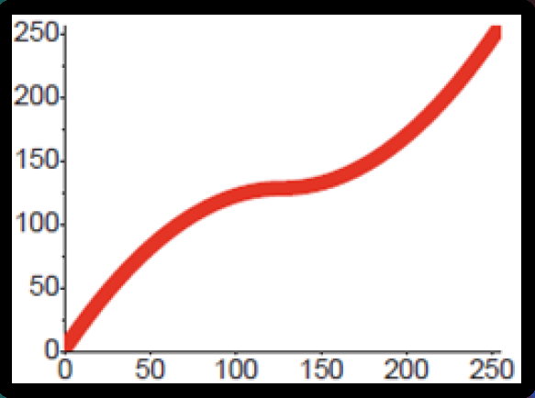
Applications
Input video
Material editing
Notes:
If we manipulate shading layer by applying this curve editing operation. We can get such material editing effect. This looks pretty much like you change the surface BRDF model and re-render it. But by using the notion of intrinsic decomposition, you can do it much easier.

Slide 21


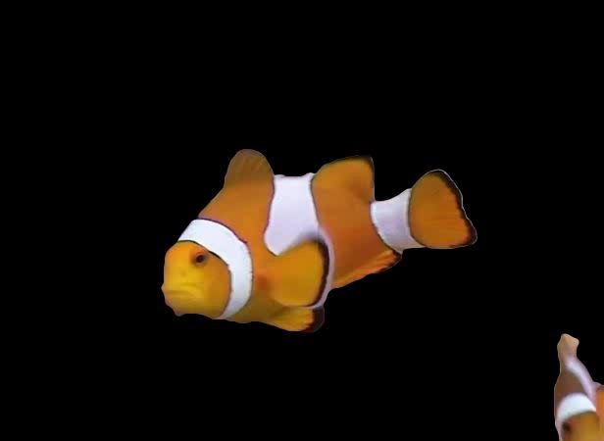
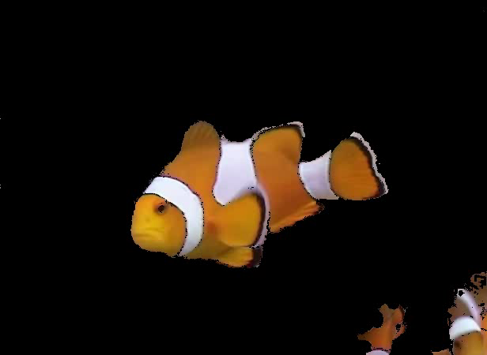
Applications
Segmentation
Graph-based segmentation
[Grundmann 2010]
Our clustering
Video snapcut
[Bai 2009]
Our segmentation
Notes:
Clusters is an inherent data structure we use. we can generate fairly good segmentation results compared to state of art video segmentation work. We compare our method to video snap cut, and we show that our method can generate much reasonable results given the condition that no user input is used during propagation.

Slide 22
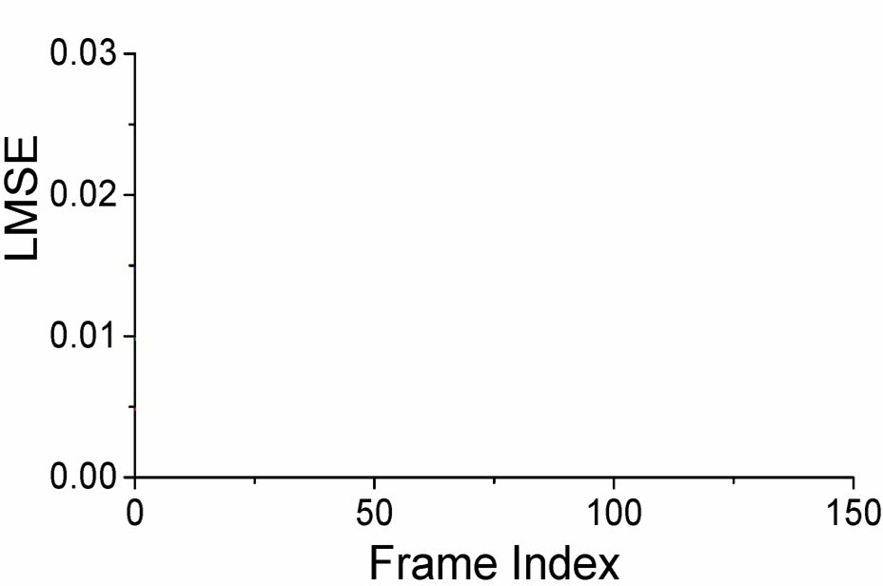


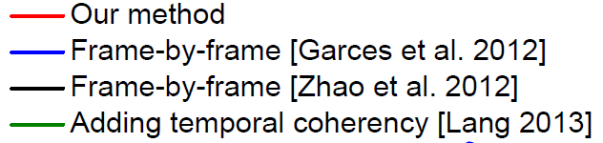
Quantitative evaluation
Ours
Groundtruth
Notes:
We also quantitatively evaluate our method by using an animated groundtruth sequence. Blue and black are applying two state of art methods for each individual frame. Green is impose temporal coherence for post smoothing after black. Red one is ours.
From the chart we can see that our method not only act in the most coherent manner but also keep the error in a smallest level.

Slide 23
Conclusion
The first work that successfully addressing intrinsic video decomposition
  A causal-anticausal, course-to-fine iterative scheme
  A probabilistic approach to propagate reflectance frame to frame
  Memory efficient, little user interaction
Notes:
In summary, we have presented a novel approach for challenging problem of intrinsic video decomposition, as well as several example applications in video editing.
To achieve that, we have propose a causal-anticausal, course-to-fine iterative scheme, which is applicable to other video processing problem ,
and a probablisitic approach to propagate reflectance frame to frame.
Our method is temporal coherent, memory efficient and does not require heavy user interaction.

Slide 24
limitation and future works
Decomposition quality
  Bounded by first frame decomposition
Temporal information
  Accuracy of optical flow
  Pixel-wise correspondence
Notes:
Our method is not free from limitation.
From the perspective of intrinsic decomposition quality. We are bounded by the best performance of the first image method we choose. Future work in this direction should be trying to overcome such limit by make a better use of temporal information.
From the perspective of video processing. There is fundamental difficulty to establish accurate per-pixel correspondence, which limit us to from a broader range of applications we can present. Maybe we can combine intrinsic decomposition and optical flow in an unified optimization in the future.

Slide 25
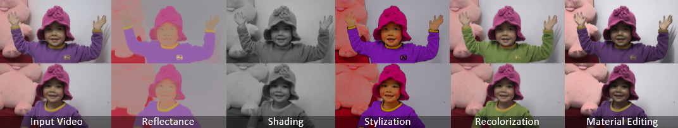
Intrinsic Video and Applications
http://media.au.tsinghua.edu.cn/yegenzhi/IntrinsicVideo.htm
Data available online!
Notes:
At the end, We publish all the testing data and results online. As we said, intrinsic video is an unexplored and uprising research area recently. We are looking forward to see much more interesting work coming out on this topic.
Now I would like to answer any questions or concerns you may have.

