Slide 1
A Similarity Measure for Illustration Style
Elena Garces Aseem Agarwala
Diego Gutierrez Aaron Hertzmann

Slide 2
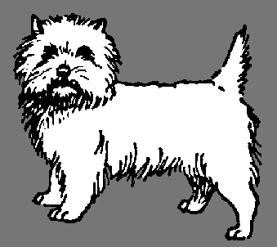
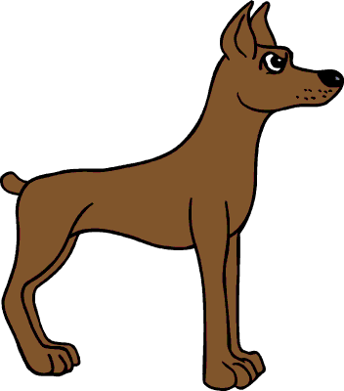
Dog clipart
Notes:
Suppose you are making a composition from clip art. You are a novice user, so your plan is to reuse existing artwork.
This is your scene, it has three different elements, a tree, a sun and few flowers.
And, although the composition is simple, its style is very well defined, it’s very coherent and harmonious.
It has smooth gradients, bright colors, and no contour line.
Now, let’s say you want to add a dog <click>, but you also want to keep the style of the composition coherent.
For this, you would normally go to google <click> and search for a dog clipart
The problem is that you will find a huge amount of dogs of many different styles, and select the one that fits in your composition is not so easy.
For example <click>, this dog here doesn’t fit as it has plain colors and black contour line
The same happens for this other one <click>
And in this other case <click>, well, it has a completely different style
<click> You have to explore hundreds thousands of dogs in order to find a good match.

Slide 3
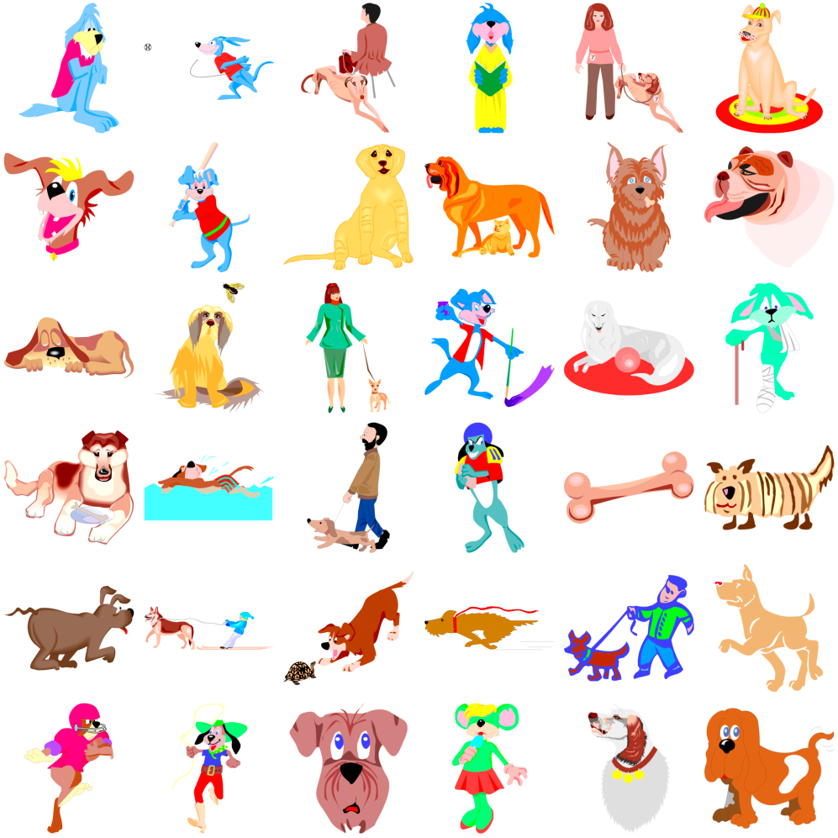
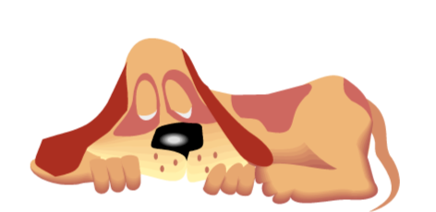
Dog clipart
What defines STYLE?
Notes:
Instead, what you would like is to tell the searcher:
“Find me dog of a similar style to my composition” <click>
And the searcher would return a list of dogs sorted by their style similarity, like this <click>
Let’s pick for example this one <click>
And, as we can see it keeps the harmony of the original style.
But what is style? <click>
Define style is a very difficult task, and although there have been few attempts to define it with words, to find a unique definition of a style is too ambiguous.
For this reason, we, instead of focusing on the definition of a style alone <click>

Slide 4
What defines STYLE?
Defining pictorial style: Lessons from linguistics and computer graphics [Willats & Durand 2005]
Style Recognition:
- Paintings [Shamir et al. 2010]
- Street architecture [Doersch et al. 2012]

Slide 5
Notes:
We think that the style comes up from the combination of several elements

Slide 6
Measure STYLE similarity
$dstyle$___X__,__Y__
Notes:
And propose a metric to measure perceptual style similarity.
This function will take as input a couple of images <click>

Slide 7
Measure STYLE similarity
$dstyle$___X__,__Y__
≈ 0
Similar Style:
$dstyle$___X__,__Y__
>> 0
NOT Similar Style:
Notes:
and will return how similar their styles are
For example, in this case, these images are of similar style <click>, so their distance will be very small. <click>
In this other case<click>, the output will be far from zero since they are not of the same style.

Slide 8
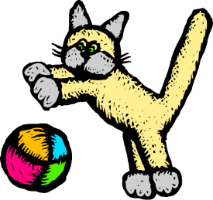
Our goal: Style Metric
$dstyle$ ,
Notes:
So, our goal is to find a style metric:
For that, we face two challenges

Slide 9
Our goal: Style Metric
$dstyle$ ,
Challenges:
How to capture illustration style?
Notes:
The first one is to find a representation of the images which captures illustration style

Slide 10
Our goal: Style Metric
$dstyle$ ,
Challenges:
How to capture illustration style?
Which characteristics are more important?
Notes:
The second one is to find out which of these characteristics are more important, so that we can compare couple of images

Slide 11
Our goal: Style Metric
$dstyle$ ,
Challenges:
How to capture illustration style?
Which characteristics are more important?
Notes:
To solve the first one, we decided to

Slide 12
Our goal: Style Metric
0.8
0.5
. . .
1
0.2
$dstyle$ ,
0.3
0.5
. . .
1
0.1
Challenges:
How to capture illustration style?
Which characteristics are more important?
feature-based
representation
Notes:
find a feature based representation of the input images<click>
We defined a set of low level features, computed over bitmaps, which capture illustration style.

Slide 13
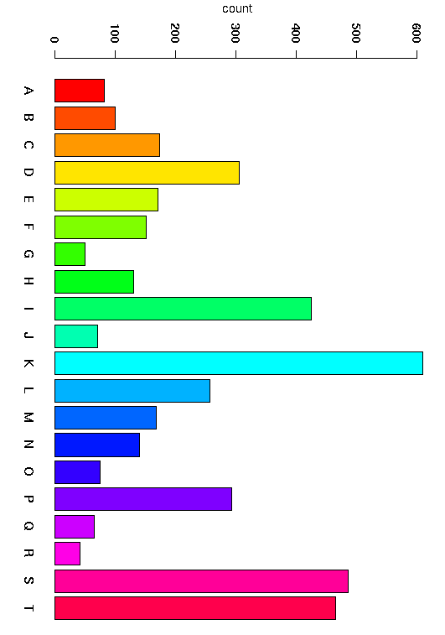
Our goal: Style Metric
0.8
0.5
. . .
1
0.2
$$\left(\begin{matrix}\begin{aligned}w_{1} \\ \end{aligned} & \begin{aligned}⋯ \\ \end{aligned} & \begin{aligned}0 \\ \end{aligned} \\ \begin{aligned}⋮ \\ \end{aligned} & \begin{aligned}⋱ \\ \end{aligned} & \begin{aligned}⋮ \\ \end{aligned} \\ 0 & ⋯ & w_{n}\end{matrix}\right)$$
$dstyle$ ,
0.3
0.5
. . .
1
0.1
Challenges:
How to capture illustration style?
Which characteristics are more important?
feature-based
representation
weight the features
Notes:
Once decided the features, we still don’t know which of them really matter,
we need to know their relative importance, that is their weights
But, How? Where do we find this information?
Since the idea of style is very personal and each person might have its own,
we decided to ask people and learned these weights from the crowd <click>

Slide 14
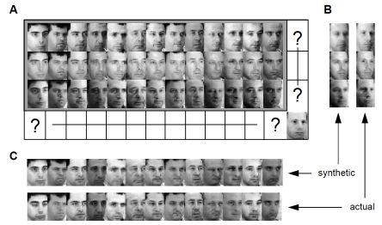
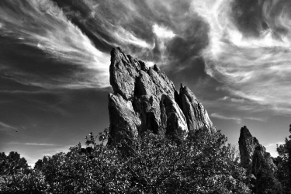
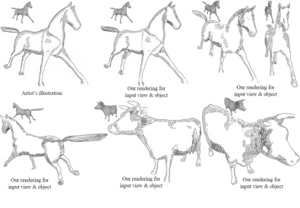
Related Work
Stylistic Rendering and Synthesis of Style
Learn generative models
Transfer styles
Painting
[Hertzmann et al. 2001]
Faces [Tenenbaum & Freeman 2000]
Photography [Bae et al. 2006]
Curves [Li et al. 2013]
Hatching [Kalogerakis et al. 2012]
Notes:
As regards to previous work in this area, most of the effort has focused on stylistic rendering and synthesis of styles.
Such as learning generative models for typefaces or hatching
Or transfer style in paintings, photography or curves

Slide 15
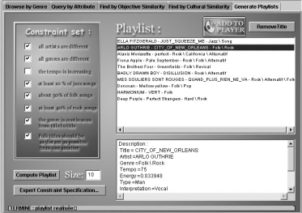
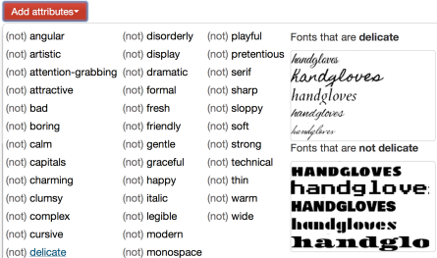
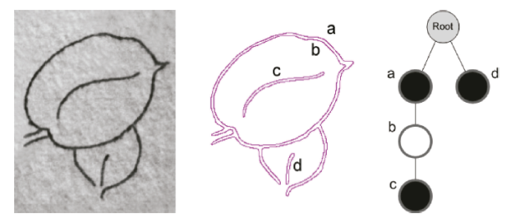
Related Work
Style similarity functions
Music
Films
Fonts
[Aucouturier & Pachet 2002]
[Bell & Koren 2007]
[O’Donovan et al. 2014]
Illustration
[Hurtut et al. 2011]
Style-based retrieval of black&white line drawings
Notes:
The problem of finding style similarity fuctions in subjective domains
Such as music or films has been studied with several levels of success
For example, nowadays we can use applications like Pandora to find music of a similar style to a given one
However, there is nothing much about style similarity in illustration.<click>
A shy attempt was done by Hurtut et al. in 2011 for b&w line-drawings

Slide 16
Overview
APPLICATIONS
TRAINING DATA
Illustration
Clip-art
Style Visualization
Search by Style
Mash-up App
A B C
FEATURE
VECTOR
METRIC
LEARNING
DISTANCE METRIC
$d_{style}$( , )
Notes:
Let’s start with the overview of our method.
Our input is a dataset of illustration clip-art.
First, we represent these data with a feature vector which captures style.
Then, we collected data on the human perception of style similarity.
This data will serve us to learn a distance metric using existing metric learning techniques
Finally, we propose three applications where our metric would be useful
--

Slide 17
Overview
APPLICATIONS
TRAINING DATA
Illustration
Clip-art
Style Visualization
Search by Style
Mash-up App
A B C
FEATURE
VECTOR
METRIC
LEARNING
DISTANCE METRIC
$d_{style}$( , )
Notes:
In order to find the ideal feature vector, we needed to design or select a number of features which would serve to capture several aspects of style while, at the same time, ignore the particular shape of the images. That is, we didn’t care if it was a dog or a cat.

Slide 18
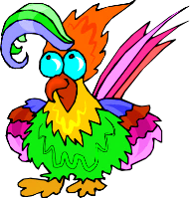
Feature Vector: Style Definition
Color
Shading
Texture
Stroke
Color
Shading
Texture
Stroke
$$x$$
Notes:
Therefore, we divided the features in four main blocks: color, shading texture and stroke <click>
Each of these blocks will contribute, with different number of bins, to form the feature vector, which we will call x

Slide 19
Feature Vector: Style Definition
Color
Shading
Texture
Stroke
$$x$$
Colorfulness measures
Hue and RGB Distributions
Saturation
Luminance
…
Notes:
Let’s start with the color features.
The main aspects of color style that we identified were the number of colors, saturation and brightness levels and if the image is b&w or not.
Therefore, we computed some colorfulness measures and other statistics

Slide 20
Feature Vector: Style Definition
Color
Shading
Texture
Stroke
$$x$$
Colorfulness measures
Hue and RGB Distributions
Saturation
Luminance
…
Notes:
We can see here the color bins for a b&w image.

Slide 21
Feature Vector: Style Definition
Color
Shading
Texture
Stroke
$$x$$
Colorfulness measures
Hue and RGB Distributions
Saturation
Luminance
…
Notes:
And here the bins for a very colorful one.
And as we can see, these images can be easily differentiable by their set of color features

Slide 22
Feature Vector: Style Definition
Color
Shading
Texture
Stroke
$$x$$
Histogram of gradient magnitudes
Whole image
Ink edges
Notes:
Shading is a very important aspect of style.
It helps to distinguish between a realistic image from a more cartoony one.
We compute histograms of gradient magnitudes at two resolutions, at the whole image and only at ink edges

Slide 23
Feature Vector: Style Definition
Color
Shading
Texture
Stroke
$$x$$
Histogram of gradient magnitudes
Whole image
Ink edges
1x
0.5x
1x
0.5x
Notes:
These are the histograms of the images shown,
They differ in ink edges, but also at some particular bins of the whole image histogram.

Slide 24
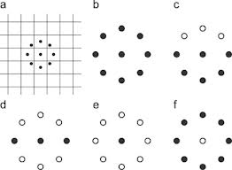
Feature Vector: Style Definition
Color
Shading
Texture
Stroke
$$x$$
Repeated Patterns
Local Binary Patterns [Ojala 1994]
Haralick Texture Features [Haralick 1979]
Notes:
Texture features find repeated patterns over the images.
We computed Local Binary Patterns and Haralick Texture Features

Slide 25
Feature Vector: Style Definition
Color
Shading
Texture
Stroke
$$x$$
Statistics about stroke width and homogeneity
Inner Edges
Outer edges
Notes:
Finally, we also have a bunch of features to capture statistics about stroke widthness and homogeneity.
We consider diferently the inner from the outer edges of the figures since in many styles these are different.

Slide 26
Feature Vector: Style Definition
Color
Shading
Texture
Stroke
$$x$$
Notes:
To sumarize, each image will be represented by a feature vector x,
that covers most important aspects of style.
As we will see later, not all the features contribute equally to the definition of style.

Slide 27
Overview
APPLICATIONS
TRAINING DATA
Illustration
Clip-art
Style Visualization
Search by Style
Mash-up App
A B C
FEATURE
VECTOR
METRIC
LEARNING
DISTANCE METRIC
$d_{style}$( , )
Notes:
Let’s talk now about our data.

Slide 28
Training Data
Not labelled data
How do we know which images have similar style?
Ambiguous problem
Notes:
We have a collection of 200,000 images of clip art of many different styles,
We can see here three samples of them.
<click> Our data is not labelled by style nor by the artist who created it.
<click> So, how do we know which images have a similar style?
<click> This problem is inherently ambiguous and impossible to solved by a computer alone.
Therefore, we collected some data on the human perception of style similarity

Slide 29
Training Data
Is A more similar in style to B or to C?
A
B
C
Notes:
We run a set of tests on A. Mechanical Turk asking this question.
We shown a triplet of images A, B, C and asked users to select if image A is more similar in style to B or to C.

Slide 30
Training Data
$${[x}_{A},x_{B},x_{C}]$$
Number of participants: 313
Random sampling
Training: 25540 relative comparisons with one opinion per comparison
Testing: 1000 relative comparisons with more than ten opinions per comparison
Notes:
Over 300 people took part in the experiments.
Where the triplets were generated randomly
In total, we gathered one set of triplets for the training with one opinion per comparison,
And another set for the testing, having ten opinions per each

Slide 31
Overview
APPLICATIONS
TRAINING DATA
Illustration
Clip-art
Style Visualization
Search by Style
Mash-up App
A B C
FEATURE
VECTOR
METRIC
LEARNING
DISTANCE METRIC
$d_{style}$( , )
Notes:
Next, once gathered the training data with crowsourcing experiments, we are ready to learn the metric

Slide 32
Metric Learning
Notes:
Recall that our goal is to obtain a distance function to compare two pieces of clip art.

Slide 33
Metric Learning
Euclidean Distance Metric
Learn $w$ using Logistic Regression [Tamuz 2011; O’Donovan 2014]
Training data: triplets ${ [x}_{A},x_{B},x_{C}]$
“Image A is more similar to B than to C“
$$\left(\begin{matrix}w_{1} & ⋯ & 0 \\ ⋮ & ⋱ & ⋮ \\ 0 & ⋯ & w_{n}\end{matrix}\right)$$
$w$ = diag($W$)
$$d_{BC}^{A}=d_{style}\left(x_{A},x_{C}\right)−d_{style}\left(x_{A},x_{B}\right)>0$$
$$\min{E(w)=−\sum_{1}^{|D|}{\log\left(\frac{1}{1+e^{−(d_{BC}^{A})}} \right)+λ{\left\|w\right\|}_{1}}}$$
Notes:
We have already defined the feature vector for the images but we still need to obtain the metric<click>
In our case it is an Euclidean Distance function, where the unknowns are the weights of the features captured by the diagonal of the W matrix
We will learn these weights using Logistic Regression techniques
And our set of training triplets.
Each triplet A, B, C meaning that “ “ will be approximated by the logistic function during the optimization
Now, let’s see the weights after this process.

Slide 34
Feature Selection
Feature weights without L1 regularization
Color
Shading
Texture
Stroke
Notes:
Our initial strategy was to initialize the feature vector with as many features as possible, because a priori we didn’t know which features were the most relevant ones
Then, after the training we noticed that many features almost disappeared while others had a huge value.
Thus, in order to further reduce the size of the feature vector we additionally applied an sparsifier using L1 regularization

Slide 35
Feature Selection
Feature weights with L1 regularization
Color
Shading
Texture
Stroke
Notes:
From an initial size of almost 200 features, it was finally reduce to around 80.
Preserving most of the color features and only some of the texture, shading and stroke

Slide 36
Evaluation
Testing set: 1000 relative comparisons with more than 10 opinions per comparison
Accuracy: % of testing triplets correctly predicted
 | Accuracy
Random | 0.5
Humans | 0.68
Oracle | 0.83
Our metric | 0.72
Notes:
For the evaluation we’ve gathered a set of triplets with at least 10 opinions per each. <click>
So, we were able to compute the accuracy as the % of testing triplets correctly predicted. <click>
We evaluated four different predictors:
A random predictor, with an accuracy of 0.5
Human predictor, which give us the average of humans agreement. This value is low because they frequently disagree.
The oracle, which is an ideal predictor which always votes for the majority opinion of the users, and thus it has a higher although not perfect value
Finally, our metric, which gets an accuracy greater than humans and the random but smaller than the oracle.
This happens because there are some ambiguous triplets that our metric misclassify, which are these triplets?

Slide 37
Ambiguous Triplets
Is A more similar in style to B or to C?
Our
Prediction
Our
Prediction
Turkers
Turkers
A
B
C
A
B
C
Notes:
In these two examples. Turkers agreed with their prediction, while we predicted the opposite.
The question was the same,
In the first case Turkers predicted B <click>while we predicted C. In this case, the three clip art are very different to each other so it is even suprising that turkers agreed without a clear winner.
For the second case <click>,<click> it seems that our metric generally believes that two colored clip arts are more similar to each other than to a b&w clip art.

Slide 38
Overview
APPLICATIONS
TRAINING DATA
Illustration
Clip-art
Style Visualization
Search by Style
Mash-up App
A B C
FEATURE
VECTOR
METRIC
LEARNING
DISTANCE METRIC
$d_{style}$( , )
Notes:
Finally, we’ll show the usefulness of our metric in three applications

Slide 39
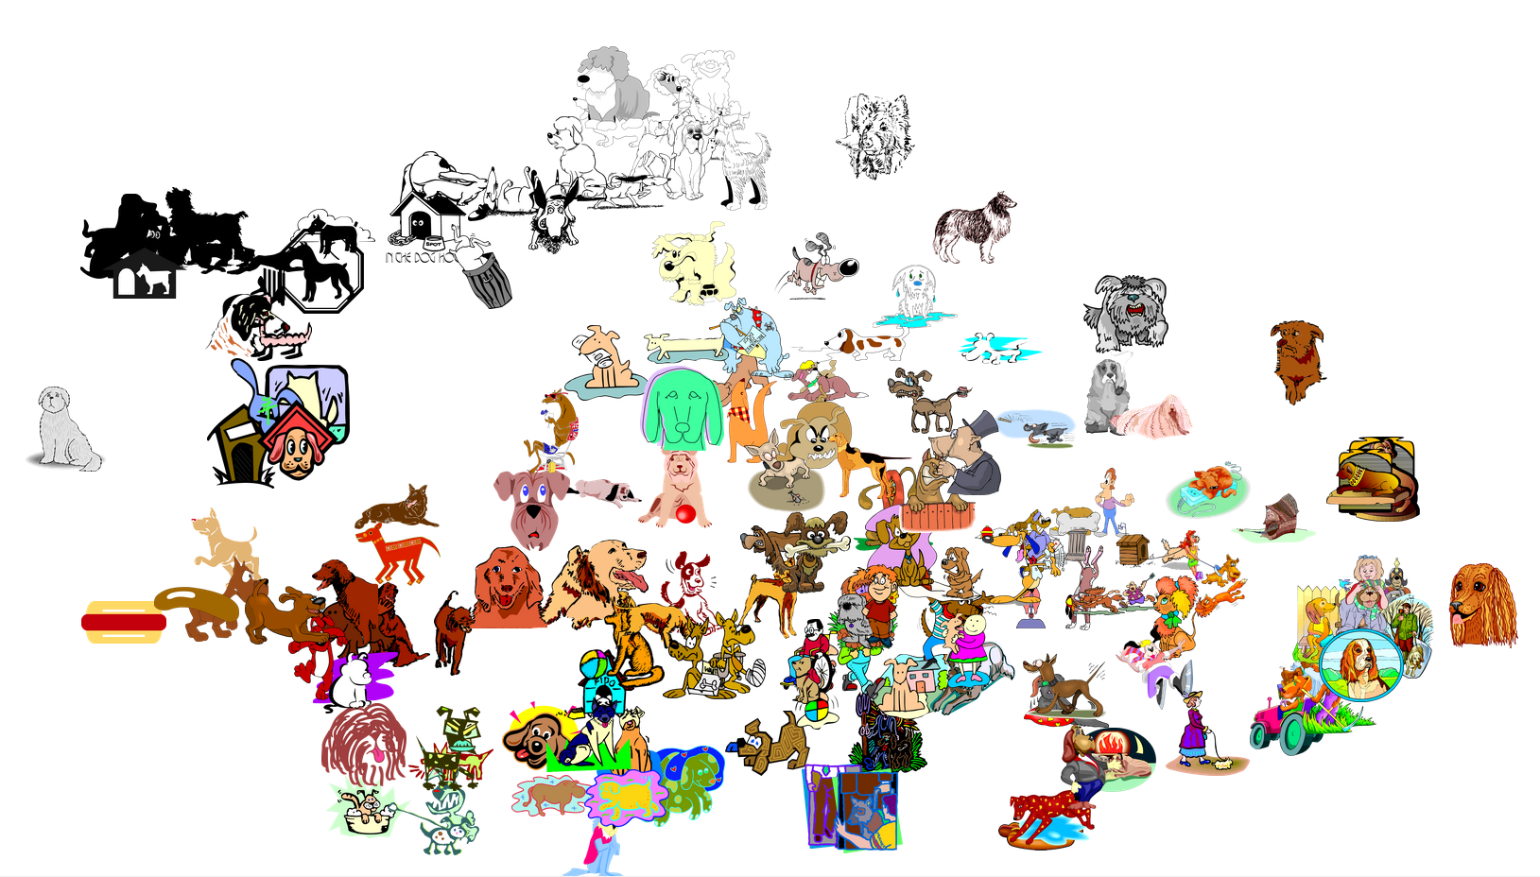
T-SNE [van der Maaten and Hinton 2008]
Notes:
The first application is style visualization.
We have selected a subset of images of our dataset. Here we can see them randomly arranged<click>
Now, we are going to apply a technique which is called t-sne which reduces a multidimensional space, like ours, into a bidimensional one. This way, we can visualize the distance between the images.
Small distances in the feature space correspond to small distances in the reduced 2D space.
Zooming in some regions, we can notice clear clusters of style <click>

Slide 40
T-SNE [van der Maaten and Hinton 2008]
Notes:
Colored and irregular strokes

Slide 41
T-SNE [van der Maaten and Hinton 2008]
Notes:
This one, with a thick black contour, and plain colors

Slide 42
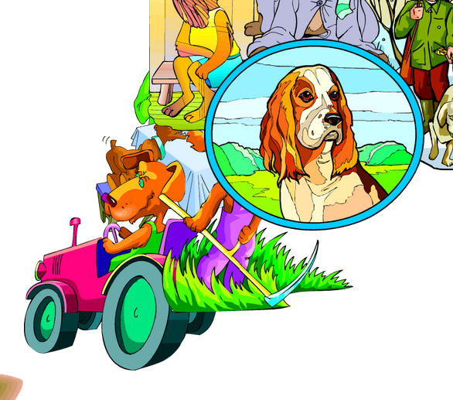
T-SNE [van der Maaten and Hinton 2008]
Notes:
And this last one very colorfull and realistic

Slide 43
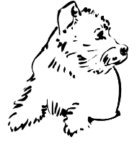
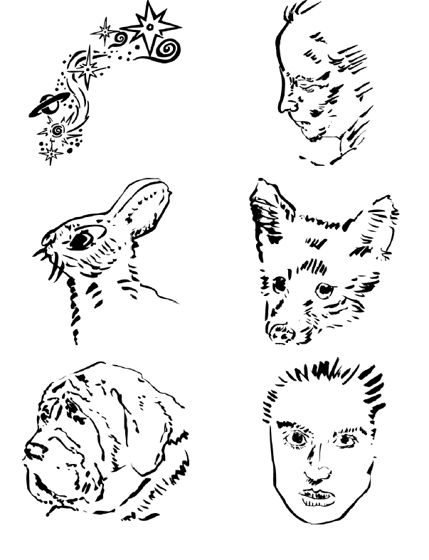
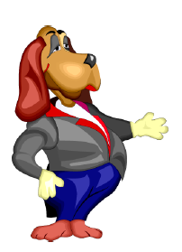
Search by Style
QUERY STYLES
200,000 images!
ALL DATASET
Notes:
The second application is the search by style
Given a query style, we can find the most similar images of the whole dataset (which is 200hundred thousand large).

Slide 44
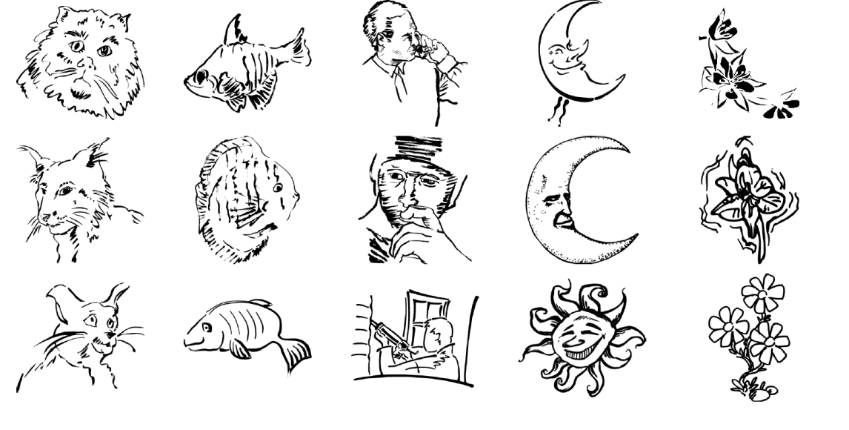
Search by Style
QUERY STYLES
ALL DATASET
CAT
FISH
MAN
SKY
FLOWER
Notes:
Additionally, if the user wants to find specific objects, we can also filter out results by its name.
We can see here an example with five different categories.

Slide 45
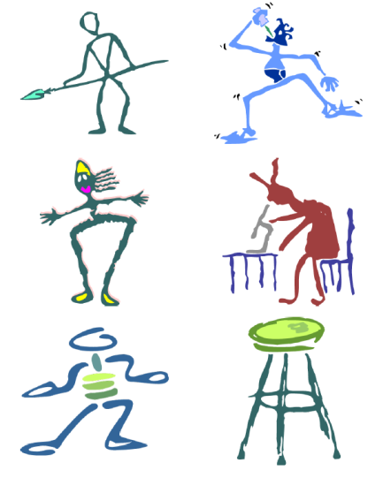
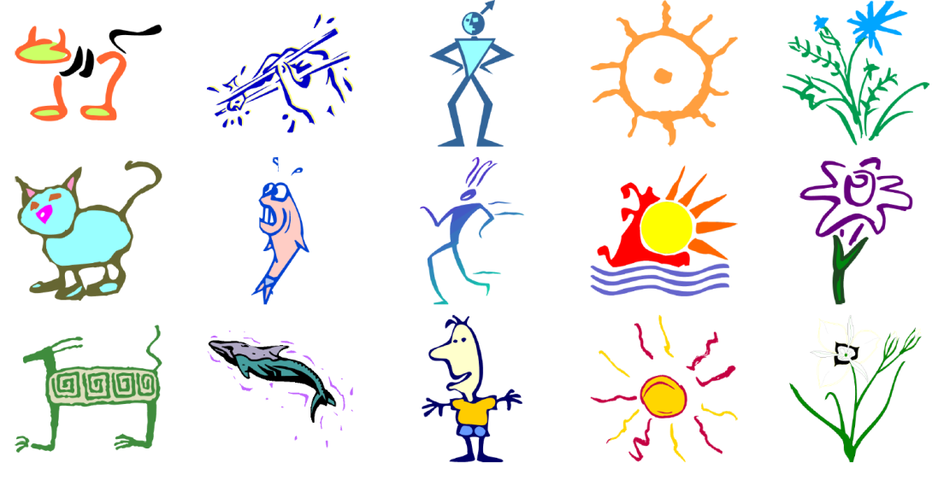
Search by Style
QUERY STYLES
ALL DATASET
CAT
FISH
MAN
SKY
FLOWER
Notes:
Here is another example of a style completely different: with colored strokes and sketchy shape, but with equally satisfactory results.

Slide 46
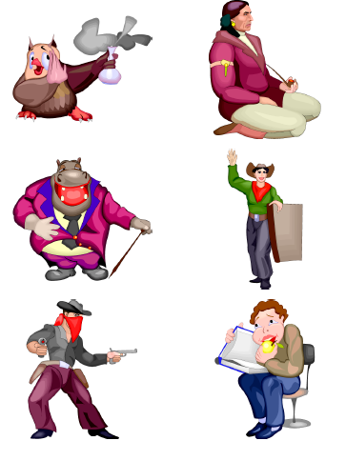
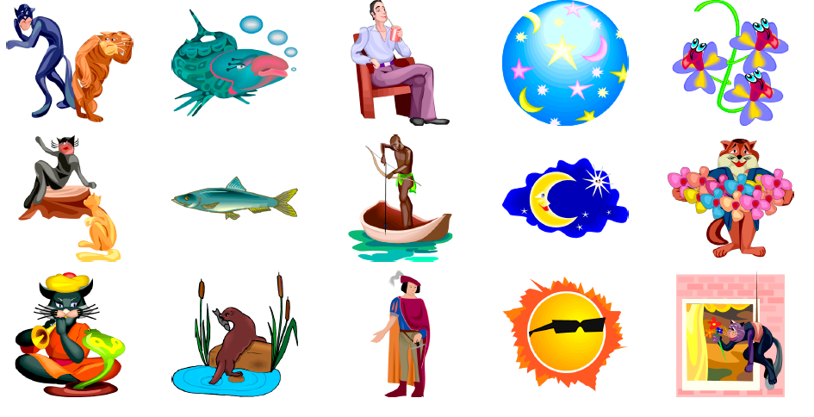
Search by Style
QUERY STYLES
ALL DATASET
CAT
FISH
MAN
SKY
FLOWER
Notes:
This last example has very characteristic shading, and realistic look.
These results show that even when the images come from different collections, they are retrieved coherently

Slide 47
Clip-Art Mash-ups
Notes:
Finally, we present our mash-up application <click>

Slide 48
Clip-Art Mash-ups
Notes:
People can create cool mash-ups using a keyword based searcher improved with search by similarity. <click>
In this example, the background is fixed so the user just have to add new elements that fit in style with it. Now, the user is not using search by similarity so the data is randomly sorted.
To find the appropiate element that fits with the original style is not easy.
When the user selects the opcion of search by similarity, the results are sorted according to the similarity in style to all the elements of the canvas. To find proper elements becomes a straigthforward task

Slide 49
Evaluation
First Study
Users were asked to create high-quality compositions
# compositions: 66 Similarity ON/ 70 Similarity OFF
Second Study
2AFC with randomly sampled compositions
Our metric was more stylistically coherent 70% (p < 0.01)
Our metric produced nicer results 66% (p < 0.01)
Notes:
We evaluated the usefulness of our metric in this kind of interaction using Mechanical Turk.
We asked users to create high-quality compositions. Some users were given a version of the interface with the metric and some others without it.
We then asked another set of users:
Which composition had a more coherent style?
Which composition produce nicer results?
In both cases results with our metric were preferred against the null hypothesis, which was that people have no preference

Slide 50
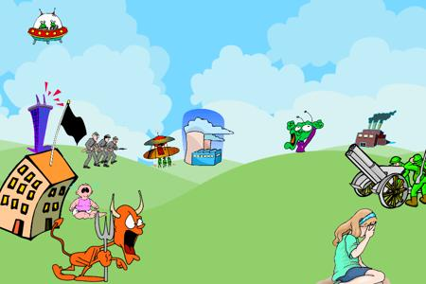
Without our
metric
With our
metric
Notes:
Here we can see a couple of example compositions created by users without using our metric,
And with our metric <click>
As we can see the compositions using our metric are better

Slide 51
Conclusions and Future Work
DISTANCE METRIC
$d_{style}$( , )
Non-linear techniques
Style naming
Style Similarity Metrics
Pictures
Clothes
Graphic Designs
Architecture
Sketchy
Woodcut
Realistic
Notes:
To conclude, we have shown a distance metric that given a query style, it can successfully retrieve images of the same style from a given dataset ignoring the content.
There are many avenues for future work, for example, we could give names to styles, so that, for example we could say find me a “sketchy” dog instead of providing a sample.
Another possible direction is to find style metrics in domains like pictures, clothes, graphic designs or architectural elements using a similar approach based on the human perception of similarity.
Finally, non-linear techniques could be useful for a deeper understanding of what defines style

Slide 52
A Similarity Measure for Illustration Style
Thank you!
Data & Mash-up Application
http://webdiis.unizar.es/~elenag/projects/SIG2014_styleSim/
Elena Garces Aseem Agarwala
Diego Gutierrez Aaron Hertzmann
Notes:
Thank you very much, all the data and the mash-up application is online. Wel… Not today because the server seems to be down, but hopefuly it will be up in a couple of days.

Slide 53
Dog clipart

Slide 54
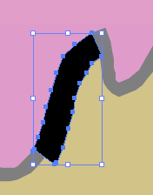
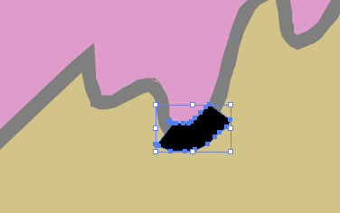
Feature Vector: Style Definition
Color
Shading
Texture
Stroke
Bitmaps vs Vector Graphics
More common representation
Non-homogeneous format of the vector graphics
Stroke from morphological
operations
Stroke from polygon
Notes:
When we first addressed this problem, we found that it wasn’t bounded.
From the huge number of image features existing in the literature, we needed to select a number of them which would serve to capture the style while, at the same time, ignore the particular shape of the images. That is, we didn’t care if it was a dog or a cat.
Therefore, we decided to separate the features in four main blocks: color, shading texture and stroke
In order to
- The problem is not bounded.
- We observe four main blocks
Our feature vector covers four main aspects of style: color, shading texture and stroke
It has a total dimension of 169 features.
computed over bitmaps because they are a more common representation,
And also because in general, the format of the vector graphics is non-homogeneous.

Slide 55
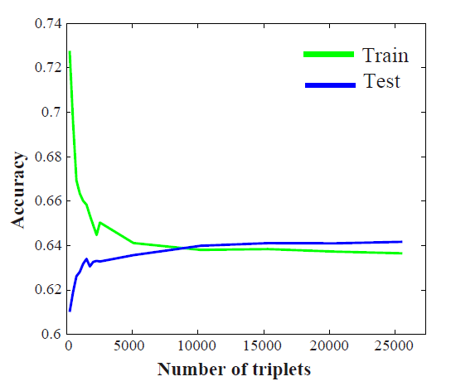
Training Data
Is this data enough?
x

Slide 56
Failure Cases
Is A more similar in style to B or to C?
A
B
C
Turkers
Our Prediction
Notes:
In the first case the three clip art are very different to each other so it is even suprising that turkers agreed so much since there is no is not clear winner.
For the second case, it seems that our metric generally believes that two colored clip arts are more similar to each other than to a b and w clip art.

